Slide 1


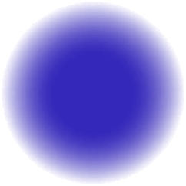



skill shikshya
PYTHON
DJANGO
https://skillshikshya.com

Slide 2

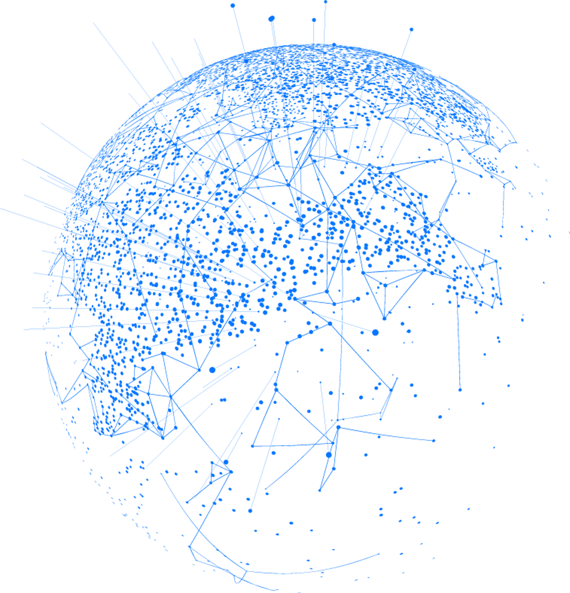
IN PYTHON

Slide 3

TABLE OF CONTENTS
BASIC PYTHON
Data structure
Function
Loops and decision making
library,threading
OOPs

Slide 4
TABLE OF CONTENTS
DATABASE
ER DIAGRAM
API,DRF
DJANGO

Slide 5
INTRODUCTION
TO PYTHON

Slide 6
WHAT IS PYTHON
->Python is a high-level, interpreted programming language known for its simplicity and readability.
-->It was created by Guido van Rossum, and released in 1991.
-->Python was named after the British comedy group Monty Python, not the snake. Guido van Rossum, Python's creator, is a fan of the group's comedy show. He chose the name because it was short, unique, and memorable.

Slide 7
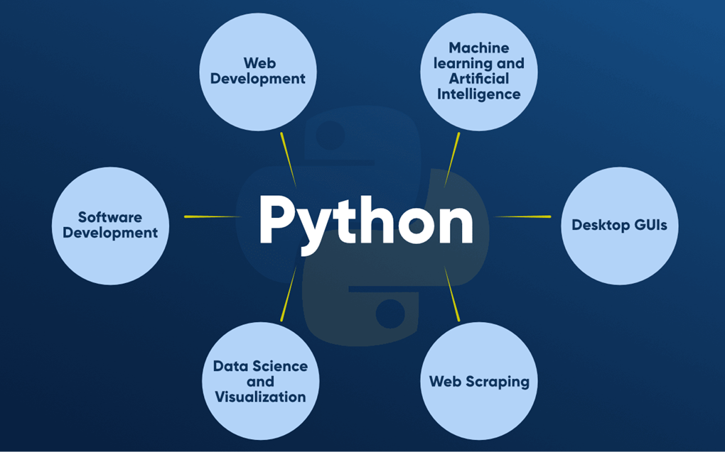
SCOPE OF PYTHON

Slide 8
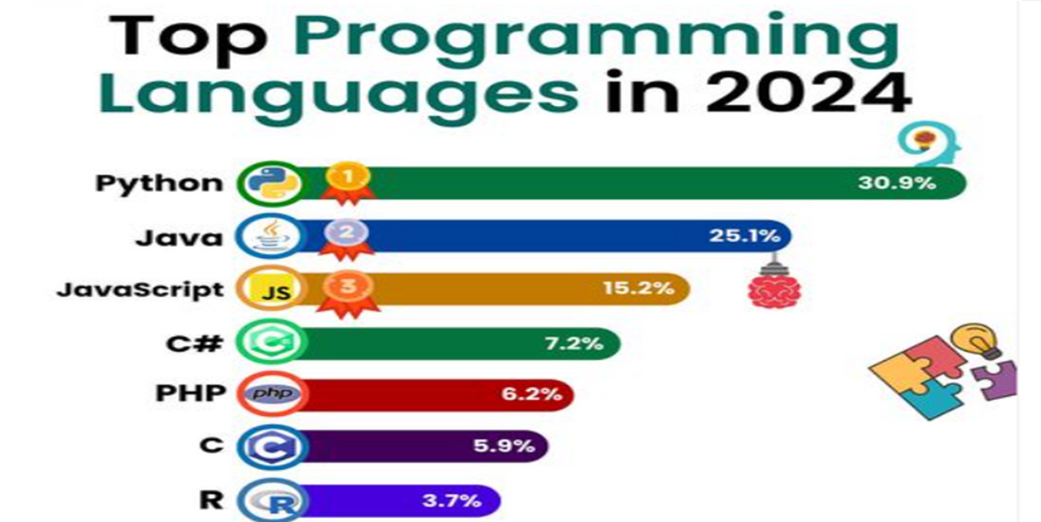
TOP PROGRAMMING
LANGUAGE IN 2024

Slide 9
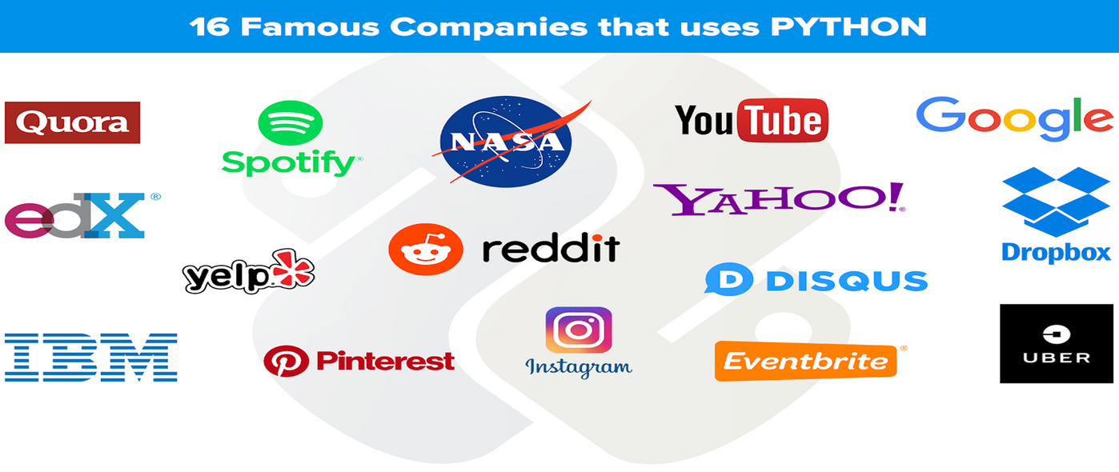
WHO USE PYTHON TODAY

Slide 10
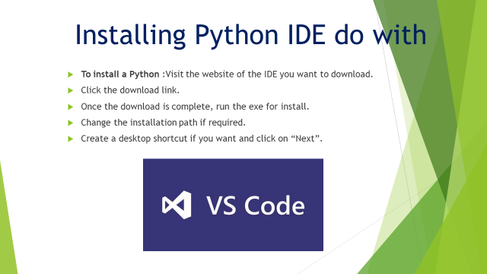

Slide 12

VARIABLES
varirable is a name which store value
a=5
name=”ram”

Slide 13
WHILE LOOP
In Python, a while loop is a control flow statement that allows you to execute a block of code repeatedly while a given condition is true.
The condition is evaluated at the start of each loop iteration, and if it is true, the loop body is executed
The loop is terminated if the condition is false.

Slide 14
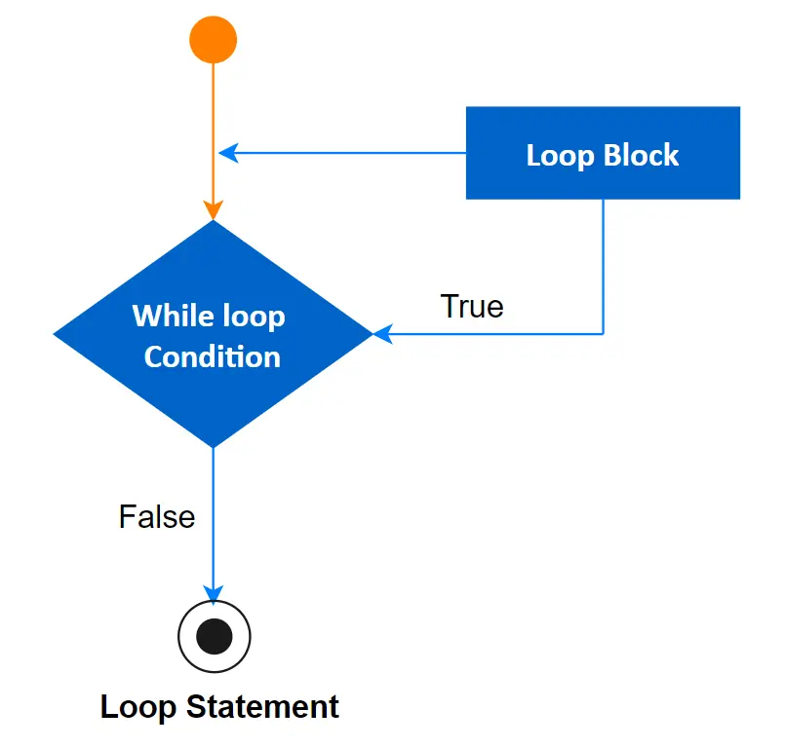
WHILE LOOP

Slide 15
SYNTAX OF WHILE LOOP
while expression:
statement(s)
Example
count = 0
while (count < 10):
print ('The count is:', count)
count = count + 1
print ("Good bye!")

Slide 16
FOR LOOP
A for loop is a control flow statement in Python that allows you to iterate over a sequence of elements such as a list, tuple, or string.
On each iteration, the loop variable in Python will take on the value of the next item in the sequence.

Slide 17
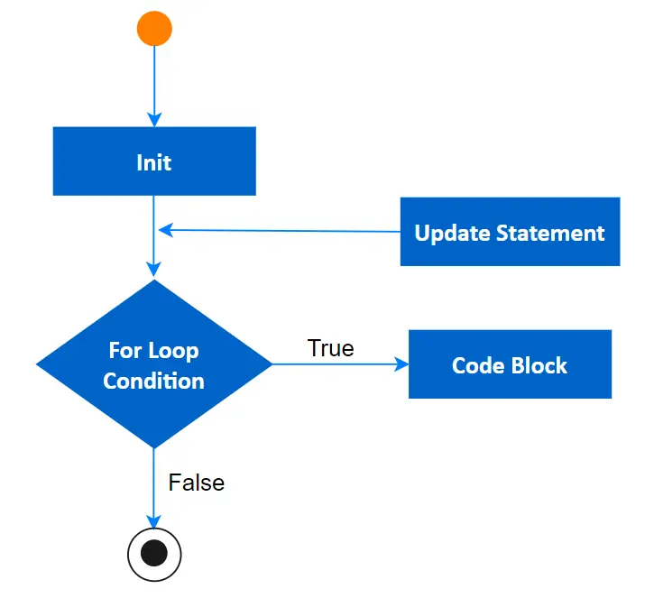
FOR LOOP

Slide 18
SYNTAX OF FOR LOOP
for iterating_var in sequence:
statements(s)
Example
for letter in 'Python': # First Example
print ('Current Letter :', letter)
fruits = ['guava', 'apple', 'mango']
for fruit in fruits: # Second Example
print ('Current fruit :', fruit)
print ("Good bye!")

Slide 19
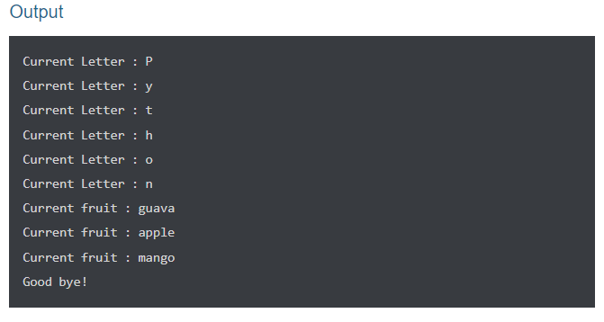
FOR LOOP

Slide 20
NESTED LOOP
In Python, a nested loop is a loop that is contained within another loop.
This indicates that the inner loop is executed within each outer loop iteration.
Nested loops are handy for iterating over a two-dimensional array or processing hierarchical data.

Slide 21
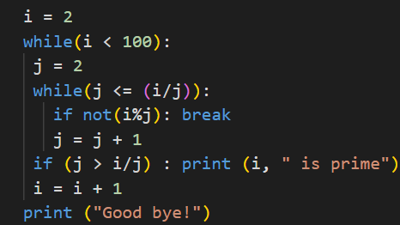
SYNTAX OF NESTED LOOP
for iterating_var in sequence:
for iterating_var in sequence:
statements(s)
while expression:
while expression:
statement(s)
Example

Slide 22
LOOP CONTROL
Break
continue
pass

Slide 23
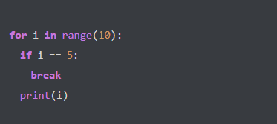
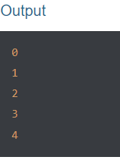
BREAK
The break statement is used to quickly stop the loop regardless of whether the loop condition is still true. This signifies that the loop will be terminated and the next statement outside of the loop will be executed.

Slide 24
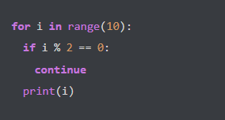
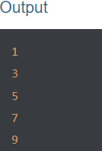
CONTINUE
The continue statement is used to skip the current loop iteration and go to the next iteration. This implies that the code from the current iteration will not be performed, and the loop will continue to iterate until the loop condition is satisfied.

Slide 25
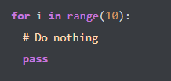
PASS
The pass statement is a null statement that has no effect. It can be utilized as a placeholder in control statements or empty loops.

Slide 26
DATA STRUCTURE
IN PYTHON

Slide 27
WHAT IS DATA STRCTURE
Data structures are specialized formats or ways of organizing and storing data in a computer's memory to facilitate efficient retrieval and manipulation of information
Data structures are specialized formats or ways of organizing and storing data in a computer's memory to facilitate efficient retrieval and manipulation of information

Slide 28
DATA STRUCTURE
LIST
TUPLE
DICTIONARY
SET
LINKED LIST
GRAPH
STRING
Queue
Heap

Slide 29
LIST
List is a collection which is ordered and changeable. Allows duplicate members
List is a collection which is ordered and changeable. Allows duplicate members
Lists are created using square brackets:
List items are ordered, changeable, and allow duplicate values.
List items are indexed, the first item has index [0], the second item has index [1] etc.

Slide 30
CREATE LIST
we can create list using 2 way.
using list constructor
list_1 = list(("ram",”shyam”,”hari”,”gopal”))
using square bracket [ ]
list_2 = [”ram", "gopal”, "hari"]

Slide 31
ACCESS LIST
list_1 = [1,2,3,4,5,6,9,23,34]
list_1[start:end:step]

Slide 32
DICTIONARY
A Python dictionary is a data structure that stores the value in key:value pairs.
A dictionary is a collection which is ordered*, changeable and do not allow duplicates.
Dictionaries are written with curly brackets, and have keys and values:
Dict = {’name: ‘skill shikshya', ‘location’: 'bagmati'}
print(Dict)
You can access the items of a dictionary by referring to its key name, inside square brackets:

Slide 33
DICTIONARY METHOD
dict.keys():- this return all keys
dict.values():-this return all values.
dict.items():-this return key pair data
dict.pop(‘key’):-this remove item
new_dict = dict.copy():-this copy to new dict

Slide 34
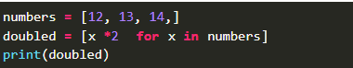
WHAT IS LIST
COMPREHENSION
A Python list comprehension consists of brackets containing the expression, which is executed for each element along with the for loop to iterate over each element in the Python list.

Slide 35
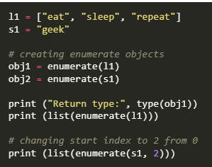
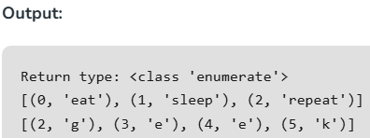
ENUMERATE() IN PYTHON
Often, when dealing with iterators, we also need to keep a count of iterations. Python eases the programmers’ task by providing a built-in function enumerate() for this task. The enumerate () function adds a counter to an iterable and returns it in the form of an enumerating object. This enumerated object can then be used directly for loops or converted into a list of tuples using the list() function.
Syntax: enumerate(iterable, start=0)

Slide 36
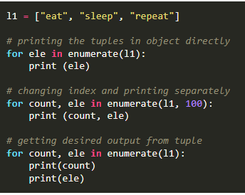
ENUMERATE OBJECT IN LOOPS
Often, when dealing with iterators, we also need to keep a count of iterations. Python eases the programmers’ task by providing a built-in function enumerate() for this task. The enumerate () function adds a counter to an iterable and returns it in the form of an enumerating object. This enumerated object can then be used directly for loops or converted into a list of tuples using the list() function.
Syntax: enumerate(iterable, start=0)

Slide 37
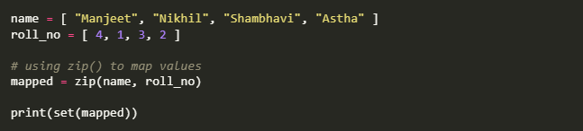
ZIP IN PYTHON
Python zip() method takes iterable containers and returns a single iterator object, having mapped values from all the containers.
{('Nikhil', 1), ('Shambhavi', 3), ('Manjeet', 4), ('Astha', 2)}

Slide 38
SET IN PYTHON
A Set in Python programming is an unordered collection data type that is iterable, mutable and has no duplicate elements.
Set are represented by { } (values enclosed in curly braces)
The major advantage of using a set, as opposed to a list, is that it has a highly optimized method for checking whether a specific element is contained in the set. This is based on a data structure known as a hash table. Since sets are unordered, we cannot access items using indexes as we do in lists.
# typecasting list to set
myset = set(["a", "b", "c"])
print(myset)
# Adding element to the set
myset.add("d")
print(myset)

Slide 39
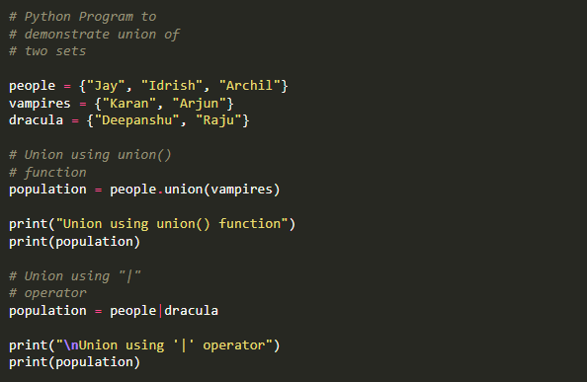
UNION OPERATION
two sets can be merged using union() function or | operator. Both Hash Table values are accessed and traversed with merge operation perform on them to combine the elements, at the same time duplicates are removed

Slide 40
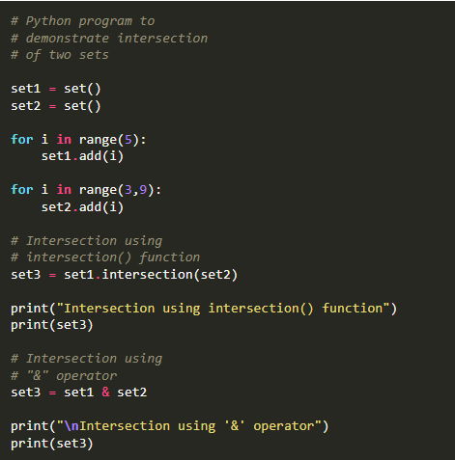
INTERSECTION
OPERATION IN SET
This can be done through intersection() or & operator. Common Elements are selected. They are similar to iteration over the Hash lists and combining the same values on both the Table.

Slide 41
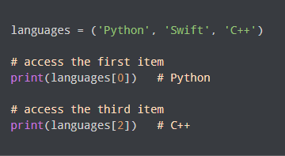
TUPLE IN PYTHON
A tuple is a collection similar to a Python List The primary difference is that we cannot modify a tuple once it is created.
We create a tuple by placing items inside parentheses ()
Tuple Characteristics
Tuples are:
Ordered - They maintain the order of elements.
Immutable - They cannot be changed after creation.
Allow duplicates - They can contain duplicate values.

Slide 42
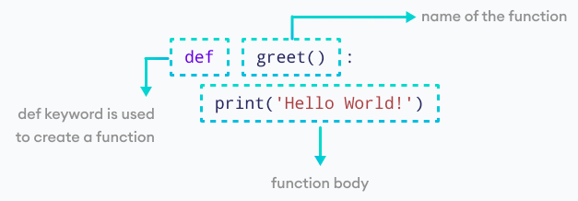
FUNCTION IN PYTHON
a function is a block of program statements which can be used repetitively in a program. It saves the time of a developer. In Python concept of function is same as in other languages.
we can create python using def keyword.
syntax:
def function_name():
print(“**”)

Slide 43
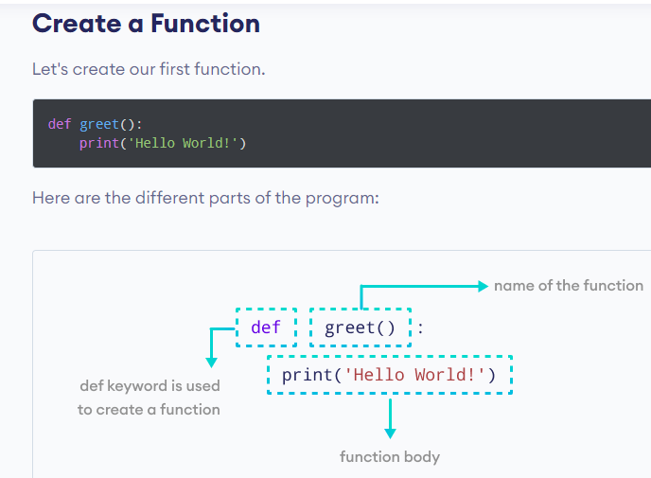
CREATE FUNCTION PYTHON

Slide 44
LAMBDA FUNCTION
A lambda function is a small, anonymous function in Python that is defined using the lambda keyword
Lambda functions can have any number of arguments but only one expression, which is evaluated and returned. They are commonly used for short, simple operations, especially as arguments to higher-order functions like map, filter, and sorted.
lambda arguments: expression
numbers = [1, 2, 3, 4]
squared = list(map(lambda x: x**2, numbers))
print(squared) # Output: [1, 4, 9, 16]
add = lambda x, y: x + y
print(add(5, 3)) # Output: 8

Slide 45
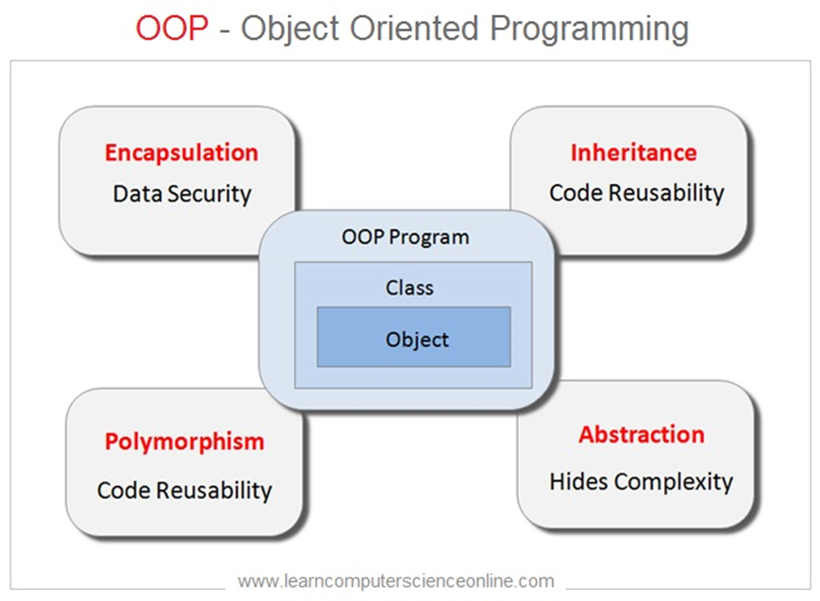
OOPS

Slide 46
OBJECT ORIENTED
in Python object-oriented Programming (OOPs) is a programming paradigm(pattern) that uses objects and classes in programming.
an object is any entity that has attributes and behaviors. For example, a parrot is an object. It has
attributes - name, age, color, etc.
behavior - dancing, singing, etc.

Slide 47
CLASS AND OBJECTS
Class: The class is a user-defined data structure that binds the data members and methods into a single unit. Class is a blueprint or code template for object creation. Using a class, you can create as many objects as you want.
Object: An object is an instance of a class. It is a collection of attributes (variables) and methods. We use the object of a class to perform actions.
State(attributes): An object has an attribute that represents a state of an object, and it also reflects the property of an object.
Behavior: An object has methods that represent its behavior.

Slide 48
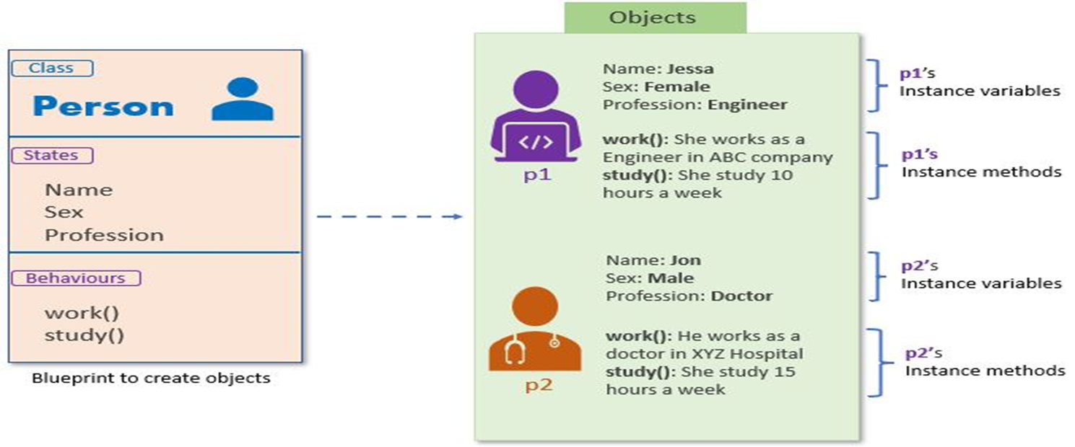
CLASS AND OBJECTS

Slide 49
A REAL-LIFE EXAMPLE OF CLASS AND OBJECTS.
Class: Person
State: Name, Sex, Profession
Behavior: Working, Study
Using the above class, we can create multiple objects that depict different states and behavior.
Object 1: Jessa
State:
Name: Jessa
Sex: Female
Profession: Software Engineer
Behavior:
Working: She is working as a software developer at ABC Company
Study: She studies 2 hours a day

Slide 50
A REAL-LIFE EXAMPLE OF CLASS AND OBJECTS.
Object 2: Jon
State:
Name: Jon
Sex: Male
Profession: Doctor
Behavior
Working: He is working as a doctor
tudy: He studies 5 hours a day

Slide 51
CLASS AND OBJECTS
SYNTAX:
class class_name:
statement 1
statement 2
statement 3

Slide 52
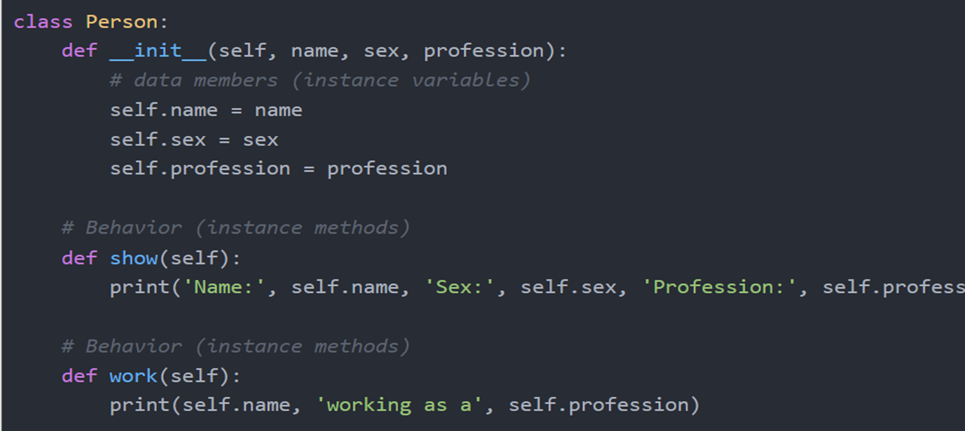
CLASS AND OBJECTS
SYNTAX:

Slide 53
INHERITANCE
One of the core concepts in object-oriented programming (OOP) languages is inheritance. It is a mechanism that allows you to create a hierarchy of classes that share a set of properties and methods by deriving a class from another class. Inheritance is the capability of one class to derive or inherit the properties from another class.

Slide 54
INHERITANCE
Python Inheritance Syntax
The syntax of simple inheritance in Python is as follows:
Class BaseClass:
{Body}
Class DerivedClass(BaseClass):
{Body}

Slide 55
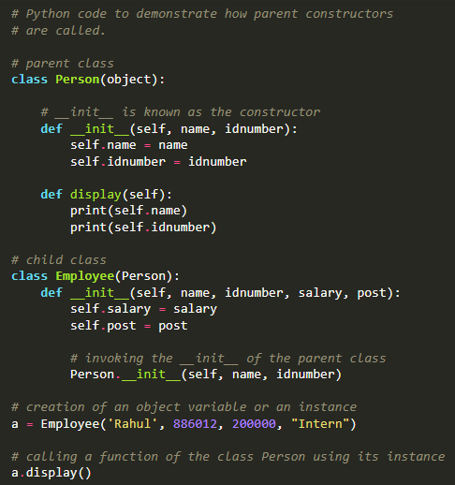
INHERITANCE

Slide 56
ENCAPSULATION
Encapsulation is a fundamental object-oriented principle in Python. It protects your classes from accidental changes or deletions and promotes code reusability and maintainability. Consider this simple class definition:

Slide 57
API
API stands for Application Programming Interface.
An API is an acronym for Application Programming Interface, an interface that defines the interaction between different software components. Web APIs determine what exactly request is made to the component. For example We define an endpoint to get the list of the students of a particular branch. It is also used on how to make the request and their expected responses.

Slide 58
IMPORTANT KEY METHODS.
GET It is most common method for get some data from component. It returns some data from the API based on the endpoint we hit and any parameter we pass.
POST It creates the new records and updates the new created record in the database.
PUT It takes the new records at the given URI. If the record exists, update the record. If record is not available, create a new record.
PATCH It takes one or more fields at the given URI. It is used to update one or more data fields. If the record exists, update the record. If the record is not available, create a new record.
DELETE It deletes the records at the given URI.

Slide 59
DJANGO REST FRAMEWORK?
Django Rest Framework (DRF) is a package built on the top of Django to create web APIs. It provides the most extensive features of Django, Object Relational Mapper (ORM), which allows the interaction of databases in a Pythonic way.
Hence the Python object can't be sent over the network, so we need to translate Django models into the other formats like JSON, XML, and vice-versa. This process is known as serialization, which the Django REST framework made super easy.

Slide 60

THANK
YOU

